Slide 1
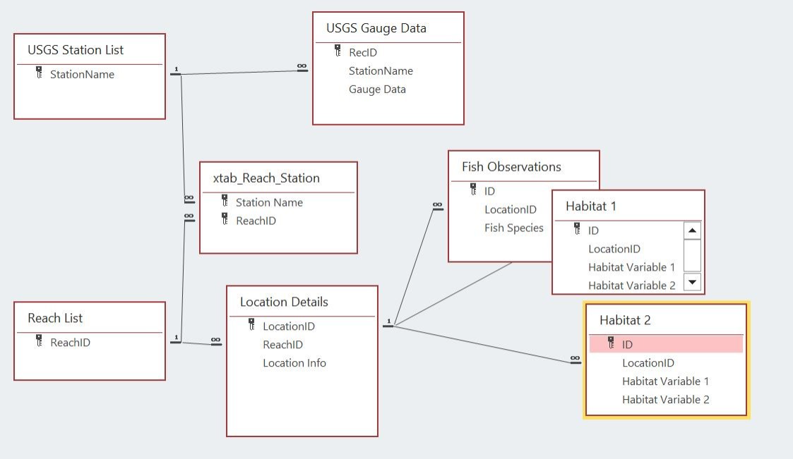
All tables can be filtered by Year
Hope

